Slide 1
Security and administration
INF08104: Database Systems
Brian Davison, 2013/14

Slide 2
Agenda
Security threats
Authentication and authorisation
Users and schemas
Row level security
Backups
Performance

Slide 3
Security threats
 | Deliberate | Accidental
Human | Abuse of privilege Spoofing | Operational error
Software | SQL injection Database rootkit Denial of Service Worms/viruses | Incompatibility
Hardware | Sabotage | Power failure Disk failure
Environment | Terrorist attack | Natural disaster

Slide 4
Security threats
Importance of technical and procedural measures
Eg Procedures for user provisioning and account review
Planning
Prevention
Detection
Recovery

Slide 5
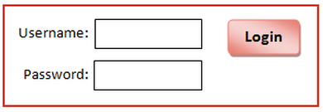
SQL injection
SELECT access_level FROM users WHERE username = '&username' AND password = '&password';
Insert into password: rubbish'; SELECT * FROM users;
Quote + semicolon terminates statement legally

Slide 6
SQL injection
Statement 1 | SELECT access_level FROM users WHERE username = 'NoName' AND password = 'rubbish';
Statement 2 | SELECT * FROM users;
Fragment | ';
Result: a complete list of all users and their details !

Slide 7
Authentication and authorisation
Authentication
Establishing identity – usually by means of shared codes eg passwords
Authorisation
Giving permission to carry out certain actions
Authorisation in Oracle
Atomic privileges
Roles: groups of privileges common to types of user
Eg resource role for schema owners, dba role for DBAs

Slide 8
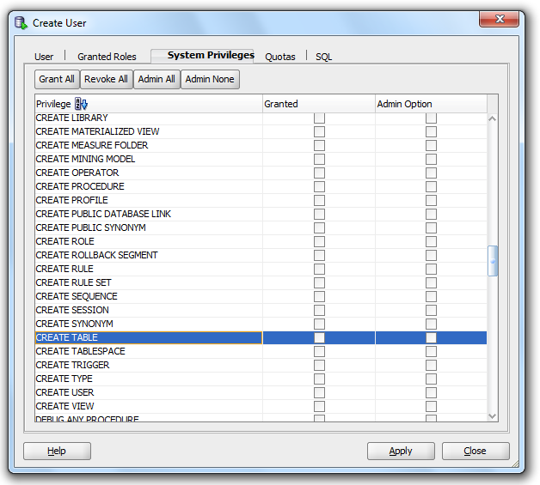
Privileges in Oracle
Privilege to CREATE, ALTER and DROP objects of different types
INSERT, UPDATE and DELETE privilege on objects
Variations on these basic operations

Slide 9
In SQL: GRANT and REVOKE
Statement | Meaning
GRANT CREATE SESSION TO bob; | Allow the user bob to start a session with the database
GRANT DROP USER TO bob; | Allow the user bob to drop user accounts
REVOKE CREATE TRIGGER FROM bob; | Remove the ability to create triggers from user bob
GRANT CONNECT to bob IDENTIFIED BY b0b123; | Change Bob's password

Slide 10
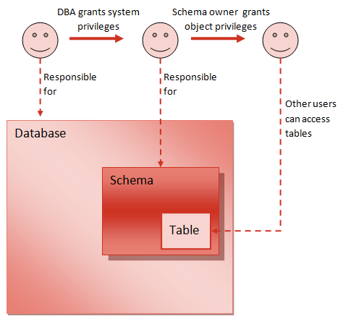
Users and schemas
Many users may access a shared schema
One user is the schema owner
Other users have different rights:
Read-only
Insert-only
Insert and Update
Insert, update, delete
etc.

Slide 11
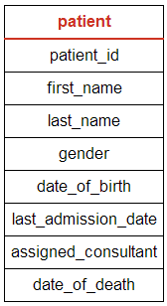
Row level security
GRANT and REVOKE only operate at the level of the object
Granularity not fine enough for all situations
eg. GP needs access to records for own patients only
CREATE VIEW assigned_patients AS SELECT * FROM patient WHERE assigned_consultant = USER;
The USER pseudo-column holds current username

Slide 12
Backups
Full
Long time required
Very large
Cost of offsite storage (per Gb?)
Incremental
Shorter time
Smaller
Restoring database requires multiple steps
Last full backup
Incremental
Incremental
Incremental
Transaction log
Transaction log
Contains a record of all transactions since last backup

Slide 13
Backup strategies
Considerations
Time to create
System availability
Cost
Time to recover
Scenarios
Mission-critical 24-hour operation
University
Small business

Slide 14
Performance
Archiving
Trade-off between data availability and performance
Regulatory limits on data retention
Indexes
Trade-off between storage requirements and performance
Table access must be analysed and/or queries carefully designed
eg. Retrieving patient records by most recent appointment
CREATE INDEX p_index1 ON patient(last_admission_date);

